Slide 1
Chapter 2: Operating-System Structures

Slide 2
Chapter 2: Operating-System Structures
Operating System Structure
Operating System Services
User Operating System Interface
System Calls
Types of System Calls
System Programs
Operating System Design and Implementation
Operating System Debugging
Operating System Generation
System Boot

Slide 3
Objectives
To discuss the various ways of structuring an operating system
To describe the services an operating system provides to users, processes, and other systems
To explain how operating systems are installed and customized and how they boot

Slide 4
Operating-System Structures
System Components
Operating System Services
System Calls
System Programs
System Structure
Virtual Machines
System Design and Implementation
System Generation

Slide 5
Common System Components
Process Management
Main Memory Management
File Management
I/O System Management
Secondary Management
Networking
Protection System
Command-Interpreter System

Slide 6
Process Management
A process is a program in execution. A process needs certain resources, including CPU time, memory, files, and I/O devices, to accomplish its task.
The operating system is responsible for the following activities in connection with process management.
  Process creation and deletion.
  process suspension and resumption.
  Provision of mechanisms for:
    process synchronization
    process communication

Slide 7
Main-Memory Management
Memory is a large array of words or bytes, each with its own address. It is a repository of quickly accessible data shared by the CPU and I/O devices.
Main memory is a volatile storage device. It loses its contents in the case of system failure.
The operating system is responsible for the following activities in connections with memory management:
  Keep track of which parts of memory are currently being used and by whom.
  Decide which processes to load when memory space becomes available.
  Allocate and deallocate memory space as needed.

Slide 8
File Management
A file is a collection of related information defined by its creator. Commonly, files represent programs (both source and object forms) and data.
The operating system is responsible for the following activities in connections with file management:
  File creation and deletion.
  Directory creation and deletion.
  Support of primitives for manipulating files and directories.
  Mapping files onto secondary storage.
  File backup on stable (nonvolatile) storage media.

Slide 9
I/O System Management
The I/O system consists of:
  A buffer-caching system
  A general device-driver interface
  Drivers for specific hardware devices

Slide 10
Secondary-Storage Management
Since main memory (primary storage) is volatile and too small to accommodate all data and programs permanently, the computer system must provide secondary storage to back up main memory.
Most modern computer systems use disks as the principle on-line storage medium, for both programs and data.
The operating system is responsible for the following activities in connection with disk management:
  Free space management
  Storage allocation
  Disk scheduling

Slide 11
Networking (Distributed Systems)
A distributed system is a collection processors that do not share memory or a clock. Each processor has its own local memory.
The processors in the system are connected through a communication network.
Communication takes place using a protocol.
A distributed system provides user access to various system resources.
Access to a shared resource allows:
  Computation speed-up
  Increased data availability
  Enhanced reliability

Slide 12
Protection System
Protection refers to a mechanism for controlling access by programs, processes, or users to both system and user resources.
The protection mechanism must:
  distinguish between authorized and unauthorized usage.
  specify the controls to be imposed.
  provide a means of enforcement.

Slide 13
Command-Interpreter System
Many commands are given to the operating system by control statements which deal with:
  process creation and management
  I/O handling
  secondary-storage management
  main-memory management
  file-system access
  protection
  networking

Slide 14
Command-Interpreter System (Cont.)
The program that reads and interprets control statements is called variously:
  command-line interpreter
  shell (in UNIX)
Its function is to get and execute the next command statement.

Slide 15
Operating System Services
Operating systems provide an environment for execution of programs and services to programs and users
One set of operating-system services provides functions that are helpful to the user:
  User interface - Almost all operating systems have a user interface (UI).
    Varies between Command-Line (CLI), Graphics User Interface (GUI), Batch
  Program execution - The system must be able to load a program into memory and to run that program, end execution, either normally or abnormally (indicating error)
  I/O operations - A running program may require I/O, which may involve a file or an I/O device

Slide 16
Operating System Services (Cont.)
One set of operating-system services provides functions that are helpful to the user (Cont.):
  File-system manipulation - The file system is of particular interest. Programs need to read and write files and directories, create and delete them, search them, list file Information, permission management.
  Communications – Processes may exchange information, on the same computer or between computers over a network
    Communications may be via shared memory or through message passing (packets moved by the OS)
  Error detection – OS needs to be constantly aware of possible errors
    May occur in the CPU and memory hardware, in I/O devices, in user program
    For each type of error, OS should take the appropriate action to ensure correct and consistent computing
    Debugging facilities can greatly enhance the user’s and programmer’s abilities to efficiently use the system

Slide 17
Operating System Services (Cont.)
Another set of OS functions exists for ensuring the efficient operation of the system itself via resource sharing
  Resource allocation - When multiple users or multiple jobs running concurrently, resources must be allocated to each of them
    Many types of resources - CPU cycles, main memory, file storage, I/O devices.
  Accounting - To keep track of which users use how much and what kinds of computer resources
  Protection and security - The owners of information stored in a multiuser or networked computer system may want to control use of that information, concurrent processes should not interfere with each other
    Protection involves ensuring that all access to system resources is controlled
    Security of the system from outsiders requires user authentication, extends to defending external I/O devices from invalid access attempts

Slide 18

A View of Operating System Services

Slide 19
User Operating System Interface - CLI
CLI or command interpreter allows direct command entry
  Sometimes implemented in kernel, sometimes by systems program
  Sometimes multiple flavors implemented – shells
  Primarily fetches a command from user and executes it
  Sometimes commands built-in, sometimes just names of programs
    If the latter, adding new features doesn’t require shell modification

Slide 20

Bourne Shell Command Interpreter

Slide 21
User Operating System Interface - GUI
User-friendly desktop metaphor interface
  Usually mouse, keyboard, and monitor
  Icons represent files, programs, actions, etc
  Various mouse buttons over objects in the interface cause various actions (provide information, options, execute function, open directory (known as a folder)
  Invented at Xerox PARC
Many systems now include both CLI and GUI interfaces
  Microsoft Windows is GUI with CLI “command” shell
  Apple Mac OS X is “Aqua” GUI interface with UNIX kernel underneath and shells available
  Unix and Linux have CLI with optional GUI interfaces (CDE, KDE, GNOME)

Slide 22
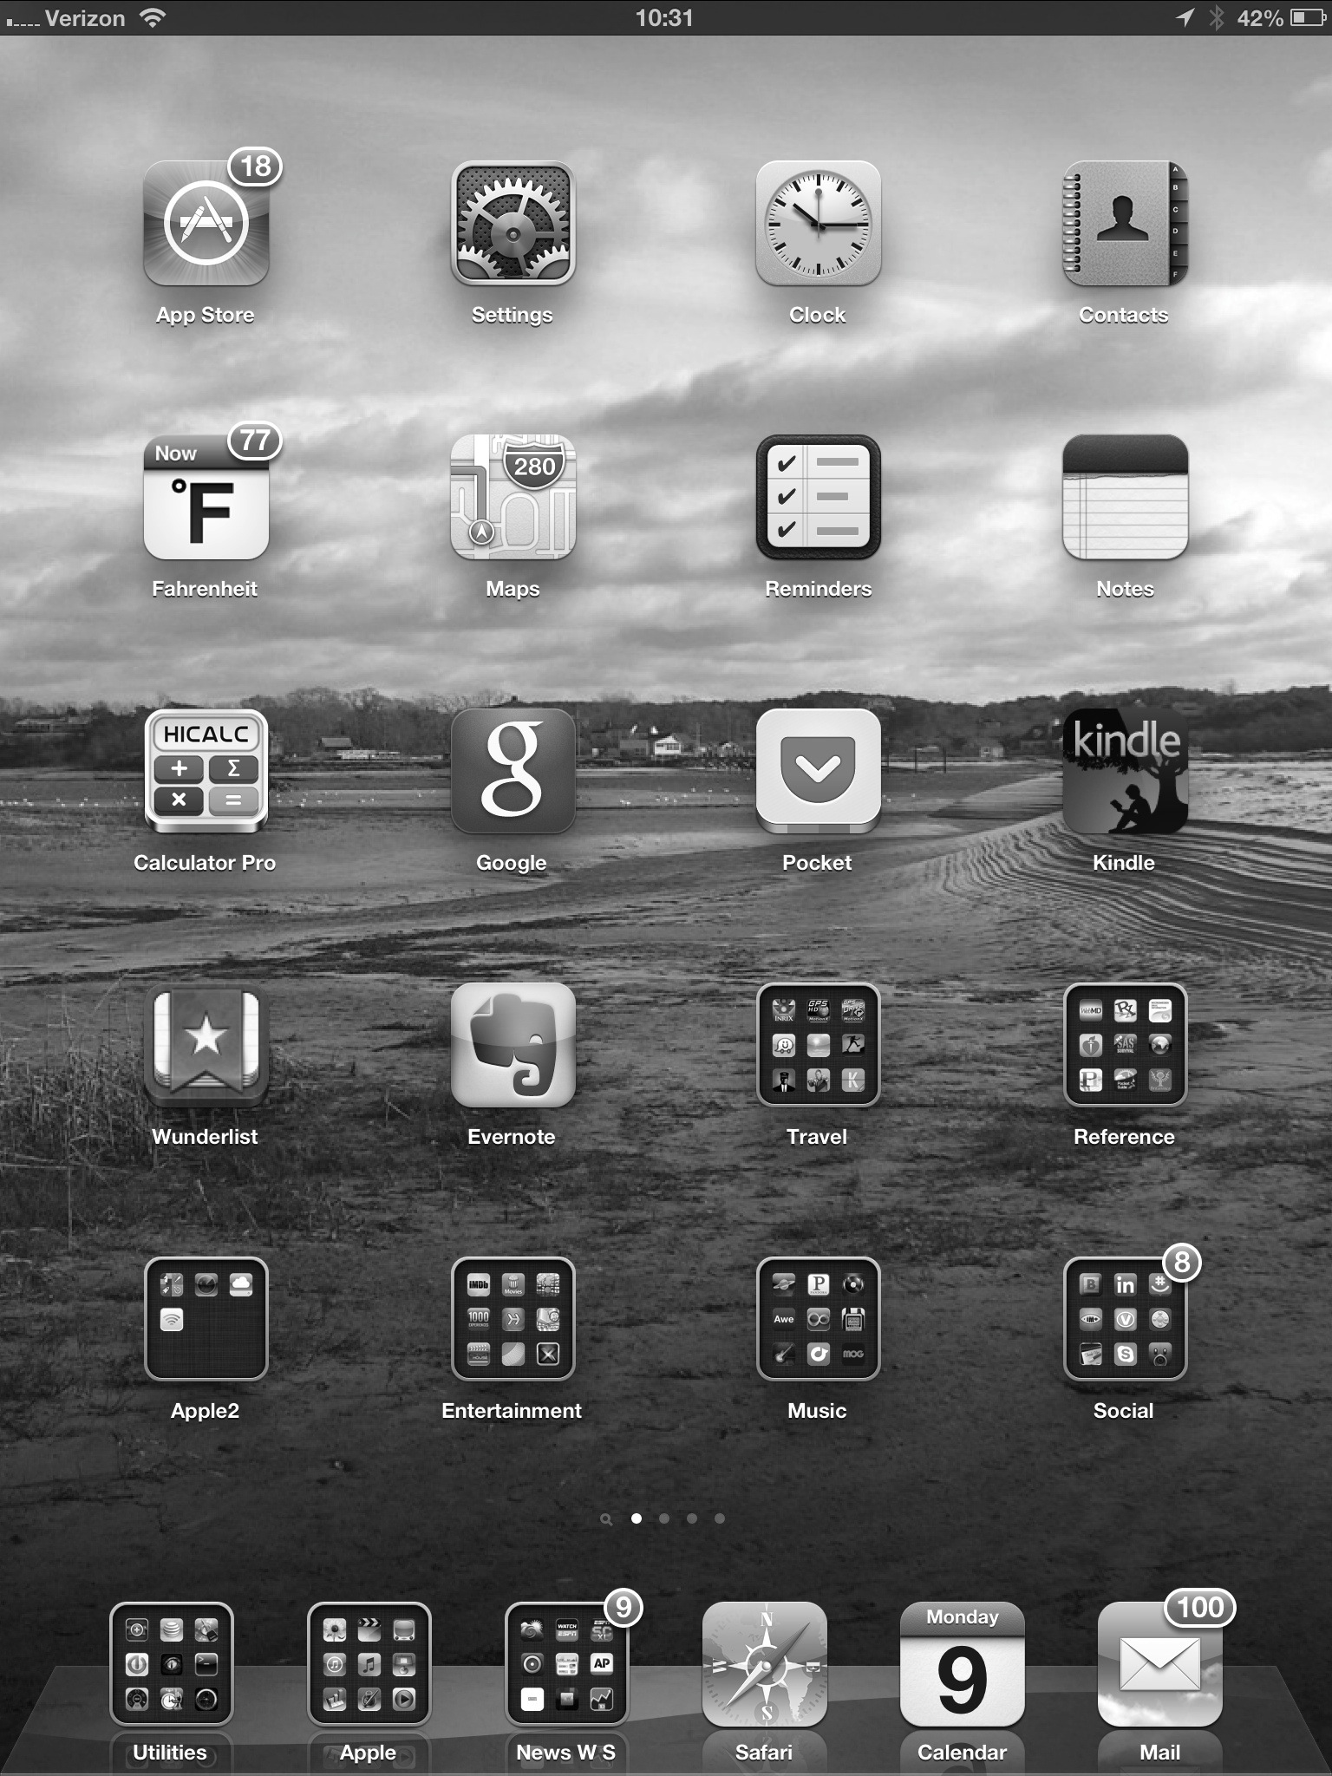
Touchscreen Interfaces
Touchscreen devices require new interfaces
  Mouse not possible or not desired
  Actions and selection based on gestures
  Virtual keyboard for text entry
Voice commands.

Slide 23

The Mac OS X GUI

Slide 24
System Calls
Programming interface to the services provided by the OS
Typically written in a high-level language (C or C++)
Mostly accessed by programs via a high-level Application Programming Interface (API) rather than direct system call use
Three most common APIs are Win32 API for Windows, POSIX API for POSIX-based systems (including virtually all versions of UNIX, Linux, and Mac OS X), and Java API for the Java virtual machine (JVM)
Note that the system-call names used throughout this text are generic

Slide 25

Example of System Calls
System call sequence to copy the contents of one file to another file

Slide 26
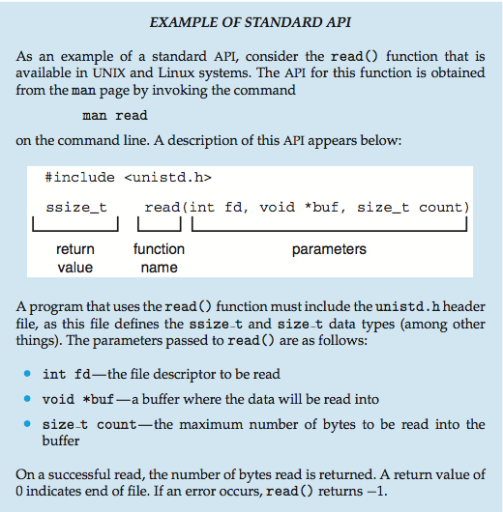
Example of Standard API

Slide 27
System Call Implementation
Typically, a number associated with each system call
  System-call interface maintains a table indexed according to these numbers
The system call interface invokes the intended system call in OS kernel and returns status of the system call and any return values
The caller need know nothing about how the system call is implemented
  Just needs to obey API and understand what OS will do as a result call
  Most details of OS interface hidden from programmer by API
    Managed by run-time support library (set of functions built into libraries included with compiler)

Slide 28

API – System Call – OS Relationship

Slide 29
System Call Parameter Passing
Often, more information is required than simply identity of desired system call
  Exact type and amount of information vary according to OS and call
Three general methods used to pass parameters to the OS
  Simplest: pass the parameters in registers
    In some cases, may be more parameters than registers
  Parameters stored in a block, or table, in memory, and address of block passed as a parameter in a register
    This approach taken by Linux and Solaris
  Parameters placed, or pushed, onto the stack by the program and popped off the stack by the operating system
  Block and stack methods do not limit the number or length of parameters being passed

Slide 30

Parameter Passing via Table

Slide 31
Types of System Calls
Process control
  create process, terminate process
  end, abort
  load, execute
  get process attributes, set process attributes
  wait for time
  wait event, signal event
  allocate and free memory
  Dump memory if error
  Debugger for determining bugs, single step execution
  Locks for managing access to shared data between processes

Slide 32
Types of System Calls
File management
  create file, delete file
  open, close file
  read, write, reposition
  get and set file attributes
Device management
  request device, release device
  read, write, reposition
  get device attributes, set device attributes
  logically attach or detach devices

Slide 33
Types of System Calls (Cont.)
Information maintenance
  get time or date, set time or date
  get system data, set system data
  get and set process, file, or device attributes
Communications
  create, delete communication connection
  send, receive messages if message passing model to host name or process name
    From client to server
  Shared-memory model create and gain access to memory regions
  transfer status information
  attach and detach remote devices

Slide 34
Types of System Calls (Cont.)
Protection
  Control access to resources
  Get and set permissions
  Allow and deny user access

Slide 35

Examples of Windows and Unix System Calls

Slide 36

Standard C Library Example
C program invoking printf() library call, which calls write() system call

Slide 37
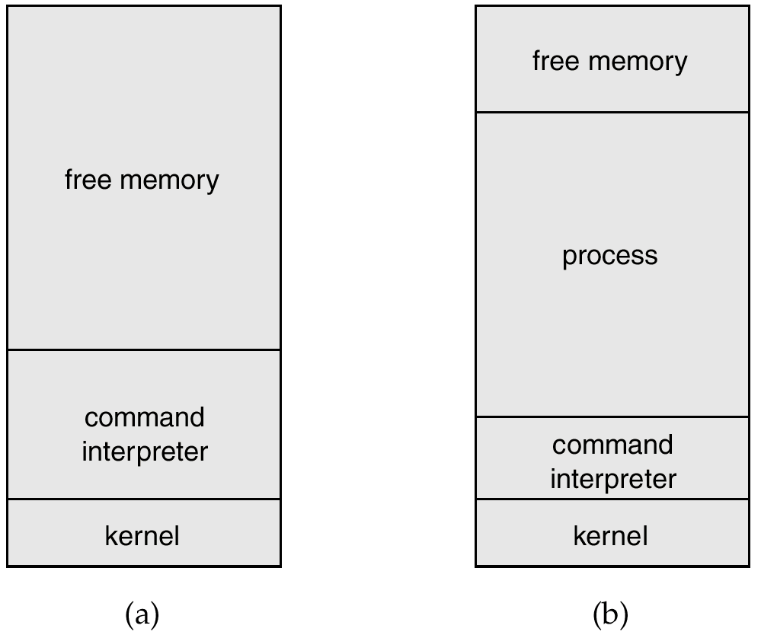
MS-DOS Execution
At System Start-up
Running a Program

Slide 38
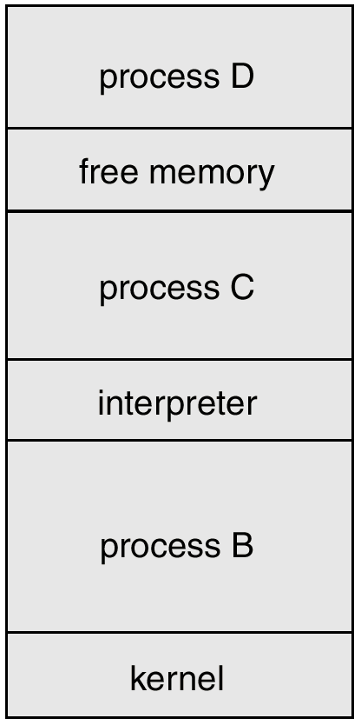
UNIX Running Multiple Programs

Slide 39

Communication Models
Communication may take place using either message passing or shared memory.
Msg Passing
Shared Memory

Slide 40
System Programs
System programs provide a convenient environment for program development and execution. The can be divided into:
  File manipulation
  Status information
  File modification
  Programming language support
  Program loading and execution
  Communications
  Application programs
Most users’ view of the operation system is defined by system programs, not the actual system calls.

Slide 41
MS-DOS System Structure
MS-DOS – written to provide the most functionality in the least space
  not divided into modules
  Although MS-DOS has some structure, its interfaces and levels of functionality are not well separated

Slide 42

MS-DOS Layer Structure

Slide 43
UNIX System Structure
UNIX – limited by hardware functionality, the original UNIX operating system had limited structuring. The UNIX OS consists of two separable parts.
  Systems programs
  The kernel
    Consists of everything below the system-call interface and above the physical hardware
    Provides the file system, CPU scheduling, memory management, and other operating-system functions; a large number of functions for one level.

Slide 44

UNIX System Structure

Slide 45
Layered Approach
The operating system is divided into a number of layers (levels), each built on top of lower layers. The bottom layer (layer 0), is the hardware; the highest (layer N) is the user interface.
With modularity, layers are selected such that each uses functions (operations) and services of only lower-level layers.

Slide 46

An Operating System Layer

Slide 47
Virtual Machines
A virtual machine is a software emulation of a real (hardware) or imaginary machine. It is completely implemented in software.
A virtual machine for the Intel 8086 processor is used to allow programs written for the 8086 to run on different hardware.
The user has the advantage of not having to purchase or maintain the correct hardware if it can be emulated on another machine. For example, if an 8086 virtual machine is available on a Sun, no 8086-compatible processor is required.

Slide 48
Virtual Machines
Java code is written for an imaginary machine called the Java Virtual Machine.
The user has the advantage of not having to purchase special hardware because the Java virtual machine is available to run on very many existing hardware/OS platforms.
As long as the Java Virtual Machines are implemented exactly according to specification, Java code is very portable since it can run on all platforms without change.

Slide 49
Virtual Machines
A virtual machine takes the layered approach to its logical conclusion. It treats hardware and the operating system kernel as though they were all hardware.
A virtual machine provides an interface identical to the underlying bare hardware.
The operating system creates the illusion of multiple processes, each executing on its own processor with its own (virtual) memory.

Slide 50
Virtual Machines (Cont.)
The resources of the physical computer are shared to create the virtual machines.
  CPU scheduling can create the appearance that users have their own processor.
  Spooling and a file system can provide virtual card readers and virtual line printers.
  A normal user time-sharing terminal serves as the virtual machine operator’s console.

Slide 51

System Models
Non-virtual Machine
Virtual Machine

Slide 52
Advantages/Disadvantages of Virtual Machines
The virtual-machine concept provides complete protection of system resources since each virtual machine is isolated from all other virtual machines. This isolation, however, permits no direct sharing of resources.
A virtual-machine system is a perfect vehicle for operating-systems research and development. System development is done on the virtual machine, instead of on a physical machine and so does not disrupt normal system operation.
The virtual machine concept is difficult to implement due to the effort required to provide an exact duplicate to the underlying machine.

Slide 53
System Design Goals
User goals – operating system should be convenient to use, easy to learn, reliable, safe, and fast.
System goals – operating system should be easy to design, implement, and maintain, as well as flexible, reliable, error-free, and efficient.

Slide 54
Mechanisms and Policies
Mechanisms determine how to do something, policies decide what will be done.
The separation of policy from mechanism is a very important principle, it allows maximum flexibility if policy decisions are to be changed later.

Slide 55
System Implementation
Traditionally written in assembly language, operating systems can now be written in higher-level languages.
Code written in a high-level language:
  can be written faster.
  is more compact.
  is easier to understand and debug.
An operating system is far easier to port (move to some other hardware) if it is written in a high-level language.

Slide 56
System Generation (SYSGEN)
Operating systems are designed to run on any of a class of machines; the system must be configured for each specific computer site.
SYSGEN program obtains information concerning the specific configuration of the hardware system.
Booting – starting a computer by loading the kernel.
Bootstrap program – code stored in ROM that is able to locate the kernel, load it into memory, and start its execution.

Slide 57
End of Chapter 2

